Slide 1
TUNED LED DRIVER AND OPTICAL RECEIVER SCHEME FOR DETECTING THE PRESENCE OF VIALS WITHIN THE TOM CAT SYSTEM`
Optical detection scheme has the following features:
Five tunable (software controlled) LED drivers.
Five fixed frequency (hardware tuned) optical receivers.
CAN Bus communications with CPU control.
Precision mechanical mounts.
Summary of development efforts :
Five led/optical detector PCBs have been developed. Circuit enhancements discovered during testing will be added. (I.e. LED current control.)
A new revision of Lab View vial to accommodate five detection channel is under development.
A calibration/tuning algorithm and firmware operating with desk top application has been developed.
A variety of RED and IR LEDS have been evaluated

Slide 2
Simplified Vial Detection Concept implemented with the DsPic33EPxxx

Slide 3
Theory of Operation for the Vial Sensor Optical Detection Hardware
Five LED light sources are modulated at frequencies ranging between 18khz and 40khz. (Optical detector response rolls off after 40khz).
LEDs are selected to operate at 940nm for all channels.
Five optical detectors are used that have a peak optical response at 900nm.
An additional index channel will be will be used to detect proper placement of a vial carrier on a track. (This can be the lowest response channel ).
Modulation channels are separated by a minimum of 3 to 5khz overall. Modulation frequencies are best when not set at an even or odd harmonic of an adjacent channel. (This improve cross modulation).
The Detection channels have a bandwidth of less than 14%. Overall channel bandwidth is related to component selection and modulation light intensity. (More light increases the bandwidth).
Modulation frequency is selected to give the best channel separation with detection channels that are adjacent to each other.
Note: Detector channel response improves slightly with increased frequency of operation. See 567 PLL data sheet.
An example is the Encoder channels: The light path is very close in proximity. In the prototype, we use two 940nm LEDs each modulated at 30khz and 40khz respectively. The frequencies selected improve response at each channel. The lower vial sensor is set to 33khz, a frequency that helps with response and has good channel separation from the upper vial sensor which is set to 27khz.
The DsPic33EP13x has a quadrature encoder module. This will be used to detect vial carrier placement and forward /backward motion of the carrier.

Slide 4
Vial Sensor Tuning Procedure for the Vial Detection Hardware
Tuning the Vial Detection hardware follows the procedure below:
Best case 0.1%(< 100ppm) resistors are selected around 1% NPO ceramic capacitors for each frequency of interest.
The detection channel center frequencies are calculated using a spread sheet.
The center modulation frequency, for each LED, is determined by sweeping the frequency of each LED until the
until the bandwidth of the detection channel is captured. (Center frequency is = Bandwidth /2 – highest detected frequency)
When tuning each detection channel , LEDs that are not in the modulation path are turned off. (i.e. when tuning the upper vial channel, the lower vial, index, and encoder channel LEDS are turned off).
The procedure is repeated for each detection channel.
Upon completion of the above tuning, the modulation source for the detection channel “under test” is turned off.
Adjacent channels are unmasked. If the detection channel “under test” does not activate, go active low, the channel is properly tuned. (i.e. when testing the upper vial detection channel tuning , the upper vial LED is masked and the lower vial and encoder LEDS are allowed to modulate.)
The procedure is repeated for each detection channel.
The above procedure is repeated until all channels are properly tuned and there is no cross modulation.

Slide 5
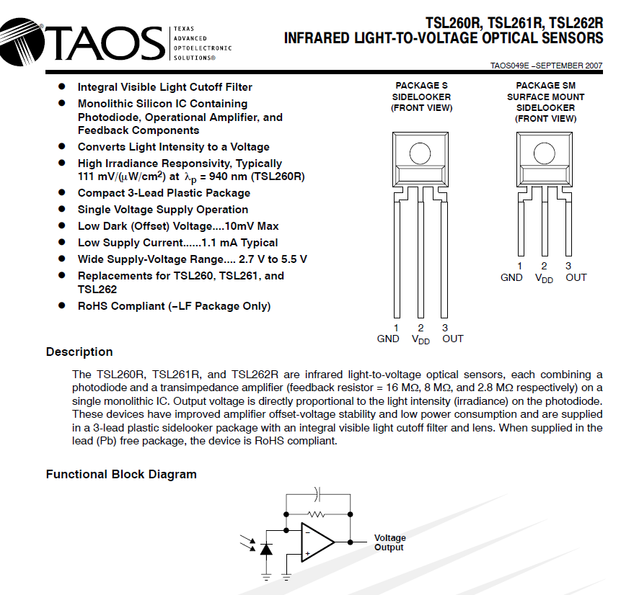
IR Optical Sensor with integrated TIA

Slide 6
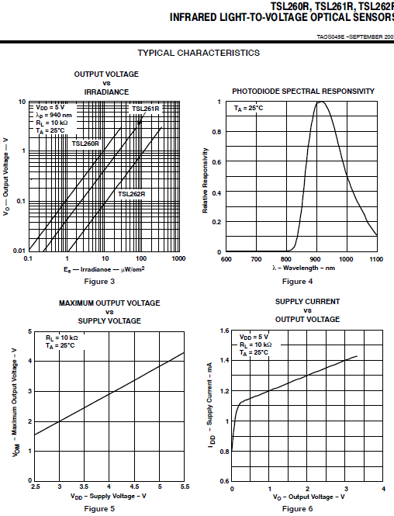
IR Sensor Response Curves.

Slide 7
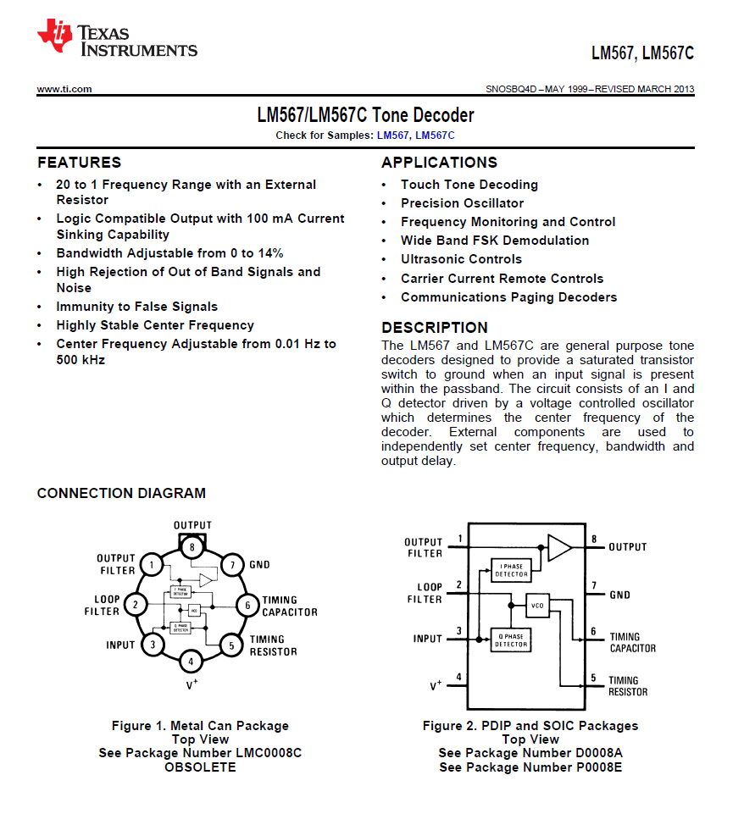
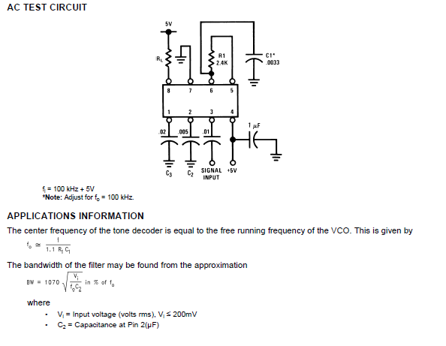
LM567 FEATURES AND CALCULATIONS

Slide 8
Example Tone Decoder Circuit
Example of Upper Vial Decoder (Fo approximately = 27hz)
R1=2k, R2=1.74K, C1=10000pF, C2=.047uF

Slide 9
Everlight IR1503 LED

Slide 10
IR1503 Operating Parameters

Slide 11
Detector board “mount “ for the Vial Detector PCB within Tom Cat System.

Slide 12
Detector PCB Dimensions for the Vial Detector PCB within Tom Cat.

Slide 13
LED PCB MOUNT

Slide 14
LED BOARD PCB DIMENSIONS

Slide 15
Summary of Testing to Date.
A five channel “fixed frequency” optical detection scheme was developed and tested.(Four board sets were tested).
Initial testing found that “cross modulation” at frequencies too close in detection will corrupt the detection event.
Improvements were made by separating modulation/ detection channels by a minimum of 5 kHz.
Due to the fast rise time of the LM567 tone decoders additional filtering and additional hysteresis was added to the detection circuitry with a dramatic reduction of glitching (easily a 99%) reduction.
Tests have been successful at a variety of forward vial carrier velocities with the vial platform fully populated with vial carriers. Average rise time for a detection channel is less than 1millisecond (500ns for 40khz).
The detection technique will sustain a forward velocity of less than 1 meter per second.
This has been tested with an algorithm developed in Lab View.

Slide 16
This slide for performance summary of Optical Detectors

Slide 21
Design Improvements/Tom Cat System Integration
Adding variable current control for the LEDs will eliminate the need for sorting LEDs.(Model results are included in this report)
This can be used to equalize out LED intensity differences and potential shading effects with non optimal mechanical mounting.
Enhancing the vial detection algorithm (adding the Index) channel will improve detection of “false” vial carrier insertion.
Porting the Lab View algorithm to the DsPic. (Do we have enough code space with the existing DsPic ?)
Integrate the Vial detection hardware into the Tom Cat system.

Slide 22
Spice Model of Variable Current Source and LED Drive

Slide 23
Linear Current Ramp Output Ramp (Modeled)

Slide 24
Current Ramp Magnified
Occasional Glitch

Slide 25
.49 Microsecond Glitch

Slide 26
Tomcat Top-Level Wiring Diagram
CAN Bus Connection Point for Vial Detection Hardware

Slide 27
Wiring Integration between the Tom Cat CPU and the Optical Detector Board.
The previous slide shows the top level block diagram of the Tom Cat system.
Power for the optical detection and LED boards will be supplied from the CAN Bus interface.
The central processor used in Tom Cat system can issue commands to the DsPic regarding house keeping, tuning, and querying for vial positions when a carrier is placed with a carrier track.

